Slide 1


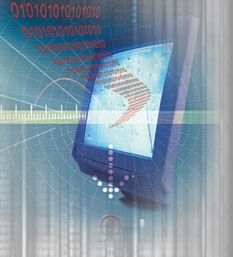
MULTIMEDIA and COMMUNICATIONS
Computer Science CS1033a/b
Lecture #9
Intro to Video (Part 1)
Instructors:
Laura Reid (section 001)
Vivi Tryphonopoulos (section 002)

Slide 2
Today’s Agenda
2 Topics Left
  Video (part2)
  Sound
  Review notes to be handed out
Announcements
Today’s Lecture
  Lect 9: Intro to Video (part 1)
“A good film is when the price of the dinner, the theatre admission and the babysitter were worth it.” → Alfred Hitchcock

Slide 3
Announcements
Major Assignment – 20%
Due Monday, Dec. 5, 2011 by 3pm
Labs will be busy again!
  Make sure you have titles set
  Animation → Creativity
  Video → Captions, Sound, Overlays
  Webpage Content → Set a standard font and font size
Don’t forget you can use FTP for up for uploading.
IF YOU ARE ON CAMPUS. You need to ftp to moodle.gaul.csd.uwo.ca Mac users may need to use fugu
If you have Windows 7, you won’t have movie maker,
you can get it for free here: http://explore.live.com/windows-live-essentials

Slide 4
Announcements
Last Lecture – Dec.2nd
  Finishing any last material
  + Important handout + practice test questions
  Don’t miss attending this lecture
TO PASS THE COURSE :
Note: you must get a weighted average of at least 45% on the final exam and major assignment
CHECK YOUR COURSE SYLLABUS

Slide 5
Today’s Agenda
Video – Part 1
What is Video
Capturing Video
Firewire vs USB
Editing Video
How TV Works
Review

Slide 6
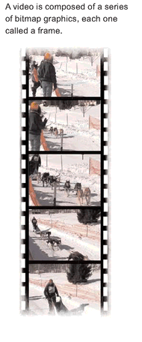
What is Video?
Video uses the power of Motion and Sound
A sequence of still images or frames that create the illusion of movement when played in succession.
Movies
Display at 24-30 fps
Computer Displayed Video
Display at 12-15 fps for smoothness
2 Types of Video:
Analog: Smooth __electronic waves__ ex. Conventional TV
Digital: each frame is a __bitmapped graphic, __ , stored
as 0s and 1s

Slide 7
How much planning goes into making a movie before the first scene is ever shot?
http://www.youtube.com/watch?v=FvQV21hkMjI&feature=related (we will just watch the first 2 minutes)
Steven Spieldberg talking about Storyboarding

Slide 8
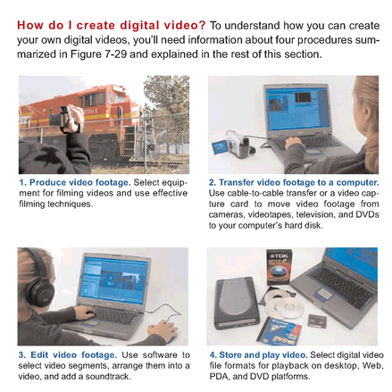
Creating a Digital Video

Slide 9
Ready to Make a Video –
Assumption: you took the footage
Let’s take a closer look!
Capture Video
Download video from camcorder to computer
Edit
Digital Video
(using Computer,
Digital Video software
ex. Adobe Premiere, Avid)
Edit it
Add all kinds of cool titles
Filters, transitions
Superimpose clips
Synchronize audio with video
Authoring software: create menus and interactivity
Output Video
Output to different file formats
Back out to tape, the Web, CD, DVD

Slide 10

Capturing the Video with Camcorders: Analog vs Digital Video
If we use an:
  Analog Camcorder:
  __Electronic impulses___ are recorded
  Must convert it to digital BEFORE we can put it on our computer to edit.
  To convert analog video to digital video we need a
  ___Video Capture Card____
  Digital Video Camcorder:
  Information is sent as 0s and 1s
  Thus no need __to convert____ !

Slide 11
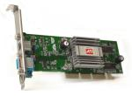
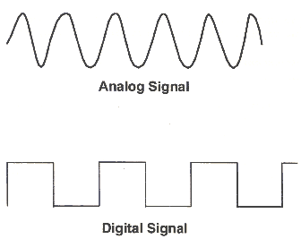
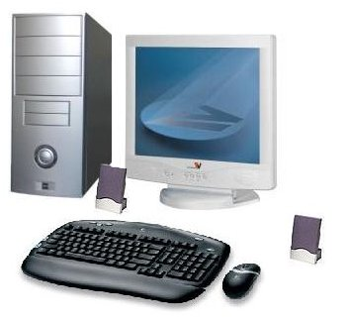

Capturing Video
Download video from camcorder to computer
To use video in a multimedia application,
it must be in digital form (0s and 1s)
So how do you get a camcorder video into digitized form?
Analog Video camera
Video card
Software:
Capturing, Editing, Outputting
Connecting Leads:
Firewire or USB cable
Digital
camera

Slide 12
Digital Video Camcorders
Most Digital Video Camcorders (DV Camcorders), do a little bit of compression right inside the camera.
DV25 is the most common DV compression used by today’s camcorders.
  DV25 Format Specs ***:
    Pixel Dimension is 720 X 480 (note this is 3:2 ratio)
    Frame Aspect Ratio either 4:3 or 16:9
    Data Rate: 25 mega bits per second (that’s why it is DV25) don’t need to know this
    Frame Rate: 29.97 fps (important ******)
    Colour Sampling: YUV 4:1:1 (compression)
    (let’s see what this means– next slide
Notes:
Memorize this specs!

Slide 13
Colour Compression In The Camera
WHAT YOU NEED TO KNOW IN ORDER TO UNDERSTAND
VIDEO COMPRESSION
For still images RGB color (for website) model is commonly used
For video the model is YUV (YIQ) or YCbCr (model =color space)
    Y → luminanace (_brightness__)
    UV or (CbCr) → chrominance (__color/hue___)
Question: Black and White TV only used the ____ signal
(fill in the blank with Y, U or V)
Question: Which one will the human eye detect changes in more easily?
How does this help us with compression?
Answer:
Y (luminance)
Answer: Human eye is more sensitive to variations __in brightness__ (our eyes have more rods which detect __brightness__. Cones detect __color___ but we have fewer of them.
THUS, VIDEO COMPRESSION works on reducing _COLOR_
- Use Color Sampling technique

Slide 14
Color Compression for Video *****
Color Sampling:
Refers to compression technique for video
You may see compression values such as
4:1:1 4:2:0 4:4:4
Scale: 4 – no compression
0 – max compression
4:4:4 – means no compression
Color Sampling Method
4:4:4
4:2:2
4:2:0
4:1:1
X:Y:Z
HOW MUCH COMPRESSION FOR the
X- __brightness__
Y, Z – __color__
Notes:
KNOW ALL OF THIS FOR THE EXAM****** very important

Slide 15
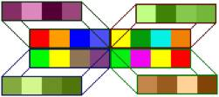
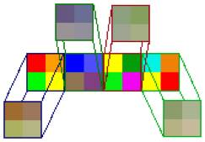
Color Sampling Method for Video
http://dvxuser.com/articles/colorspace/
You may see that the compression used 4:1:1 Color Sampling Method, What does this mean?
  Assume we have 4 pixels →
Red, Orange, Blue, Purple
red + blue = Purple
4:1:1
Blocks of 4 pixels averaged out
4 x 1 block
Result:
So all four pixels get forced to become purple (shades of brightness)
Blocks of 4 pixels averaged out
4:2:0
Blocks of 4 pixels averaged out
2x2 grid block
Notes:
Don’t need to know this for exam

Slide 16
Color Sampling Method for Video
Remember:
X:Y:Z (ex.4:4:4)
  X- brightness
  Y, Z – color
  4- no compression, 0-full compression
http://dvxuser.com/articles/colorspace/
Color Sampling Method | Amount of Y (luminance) | Amount of U (color or hue) | Amount of V (color or hue) | Amount of Compression | Used in
4:4:4 | 4 samples | 4 samples | 4 samples | None 12 samples for each group of 4 pixels
4:2:2 | 4 samples | 2 samples | 2 samples | Reduced from 12 samples to 8, 33% reduction in storage | Digital Betacam format
4:2:0 | 4 samples | 2 samples of either U or V, one scan line of U, then one scan line of V |  | 12 to 6, 50% reduction in storage | HDV, MPEG-1, DVD, MPEG-2, PAL DV
4:1:1 | 4 samples | 1 sample | 1 sample | 12 to 6, 50% reduction in storage | NTSC DV, miniDV digital camcorder
Notes:
Don’t need to memorize compression, pretty much just know color sampling method!

Slide 17
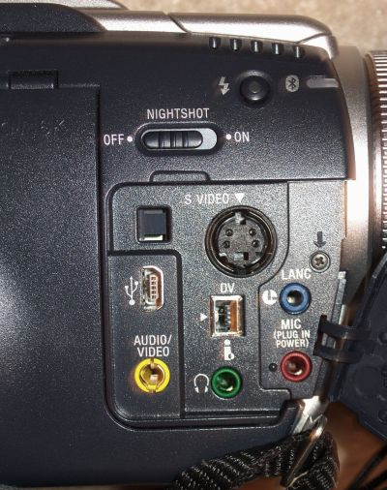
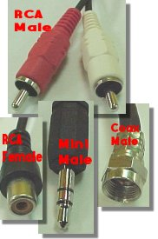
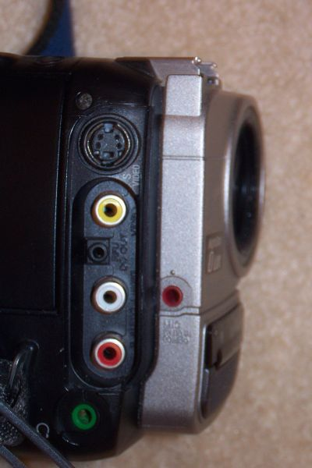
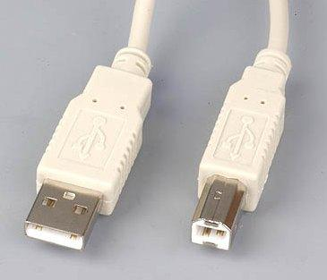
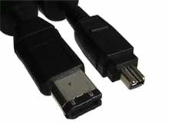
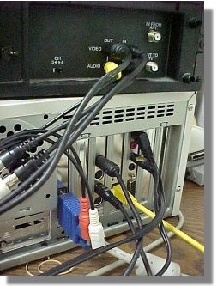
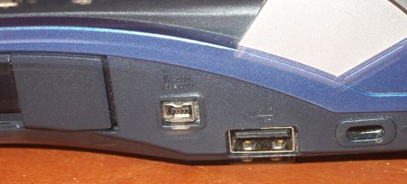
Connection Types
To get the video off of your camera onto a computer
Digital
Analog
Video
S video
(better quality)
Yellow RCA
USB cables
Audio
Firewire
Video Capture Card
Plugs directly
Converts video from
ANALOG TO DIGITAL
Firewire (4 pin)
USB

Slide 18
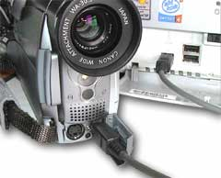
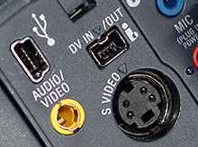
Capturing Video –Video Capture Device
Download video from camcorder to computer
Firewire ( i.Link, IEEE1394 )
A means by which information could be sent from the camcorder directly to the computer
A ___high-speed digital serial****(IMPORTANT)_____ data connection that allows the output of the camera to be fed directly into a computer in digitized form
All major manufacturers agreed to use a common digital tape format and a method -- Firewire (universal standard)
4-pin to 4-pin plugs
4-pin to 6-pin plugs
6-pin to 6-pin plugs

Slide 19
Firewire vs. USB →History****
It used to take A LONG time to move video from your camcorder to your computer (Hours and Hours)
  Firewire initiated by Apple and the IEEE in the late 80s.
  Firewire is a _high speed__ data transfer technology.
  Transmitted originally at 400Mbps
  (know these numbers!) *****
  Used to have a patent of 25 cents charged to any computer that used it; and needed hardware to run it that cost 1-2 dollars This may have caused it’s demise?
  PCs didn’t want to pay! This caused most PC manufacturers to decide against it, in favour of USB 1.1.
  So What happened next?
Notes:
KNOW THIS HISTORY IMPORTANT***

Slide 20
Firewire vs. USB
full-length HD movie in less than 30 seconds
Firewire 400
Could transmit at 400 Mbps
__Peer to Peer__ Technology
(ability to connect 4 camcorders together and move video from one to another)
PC’s solution →USB 1.1
USB 1.1 could transmit at 12 Mbps
  too slow for video, thus used for
  __mice, keyboards, printers___
  USB 2.0 (came along, backward compatible, 480Mbps
  Firewire 400 and does video Master/Salve technology
  came along, backward compatible, transmitted at 480 Mbps
  Firewire 400 and does video
  Master/Slave technology
  Currently,
Mac Laptops:
used to have Firewire but the newest technology is Thunderbolt (10Gbps - Faster than Firewire)
Apple iPods no longer have Firewire ports in them.
PCS have Firewire 800 Mbps
Feb. 23, 2011 released Thunderbolt technology
  Thunderbolt Technology
  10Gpbs
  Full length HD movie downloaded in less than 30 sec.
  details

Slide 21
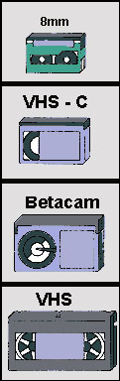
Summarizing Analog vs Digital
1983
1994
DIGITAL (Newer Technology)
Records a binary code (string of 1s and 0s) compressed on magnetic tape or other media
Adv: No image __degradation___
Plug your video camera directly into your computer via a ___Firewire___ (aka i.Link) or USB connection.
These are digital connections and allow you to "dump" footage straight from the camera to hard drive.
ANALOG (Older Technology )
Records __electrical____ signals/pulses directly onto a medium (like a tape) with a magnetic encoding.
Disadv: Picture loses quality
__Video capture card___ needed to convert video from analog to digital for your computer
Solid State Media Card - Memory Sticks

Slide 22
A little history on TVs
Digital video often adheres to standards for TV broadcasting – 2 standards: NTSC and PAL
NTSC Standard:
  Regular Analog TV broadcasting using the NTSC standard began in the United States in 1939 and carried through to today
  Frame rate was originally 30fps but when color was introduced, needed to go down to __29.97___ fps to accommodate for colour information.
PAL Standard:
  ___Britain, Europe and other countries___
  Frame rate is set for __25___ fps

Slide 23
A little history on TVs
Experiments with High Definition TV began in the late 40s and 50s but it wasn’t adopted by a single station till 1996.
Before 1996 ALL TV was broadcast using interlaced display and fields (see next slide) ****
The original ANALOG video choices made about TV display (frames per second, frame size, etc..) affect the standards that were picked for DIGITAL video and applied today!
Notes:
Red is important****

Slide 24
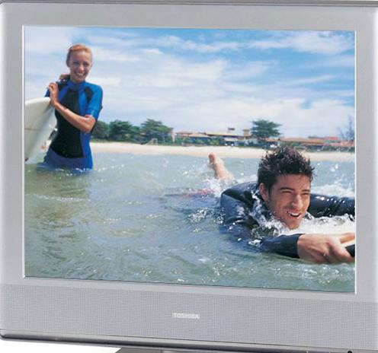
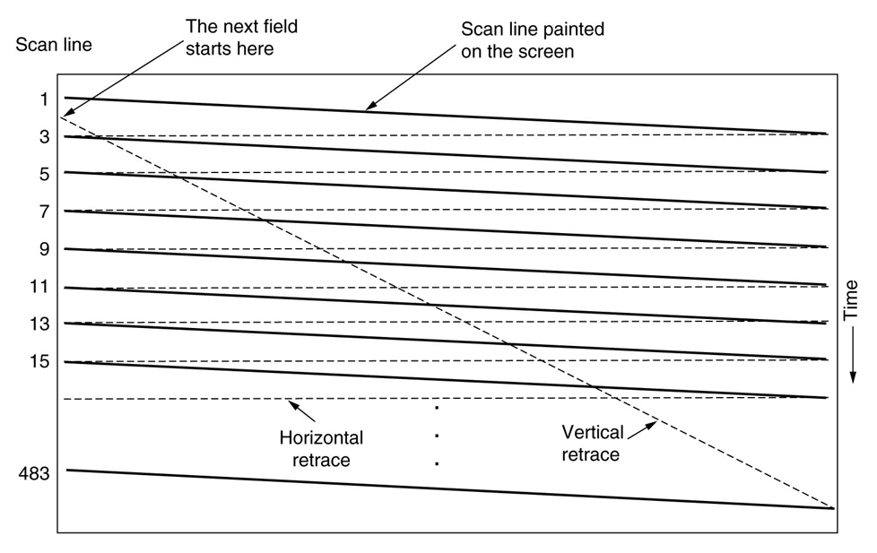
How did the original TV display work?
Our eyes see phosphor dots on the screen.
An electron beam (gun) activates the dots. The gun scans through the dots horizontally
A complete scan is when the gun starts at the top left and scans several times horizontally till it gets to the bottom right
The scan only draws every OTHER line (1,3, 5, 7, 9...479) then starts back at the top and draws the even lines (2,4,…480).
  Thus two passes
  Each pass is called a field
  The process is called __interlaced display___
This way it can cheat the eye, while the phosphor dots are disappearing, it is drawing the line underneath.

Slide 25
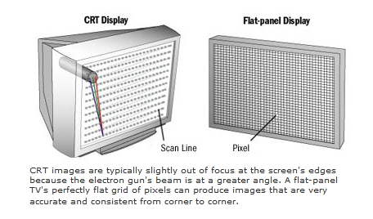

How did the original TV display work?
Interlacing effect (__old TVs___)
Line 1,3,5,7..
Line 2,4,6,8..
Progressive effect
(__Flat Screens___)
Line 1,2,3,4,5,6,7..
http://www.crutchfield.com/Learn/learningcenter/home/understanding-resolution.html

Slide 26
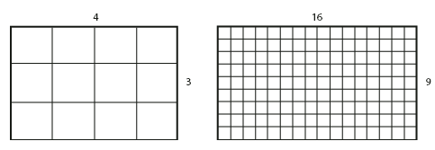
NTSC Standards ***********
  The Frame Size of
  Standard DV Frame:
  For NTSC → 720 X 480 pixels
  For Pal → 720 X 576 pixels
  Pixels are distorted (not square) because 720:480 is actually 3:2 ratio (1.5)
High Definition for NTSC:
  1440 X 1080
  1280 X 720
  Frame Aspect Ratio
  1440:1080 → ratio is 1.333 (4:3)
  1280:720 → ratio is 16:9
Frame aspect ratio is the ratio of width to height of the image frame.
4:3 Frame aspect ratio
16:9 Frame aspect ratio
Notes:
Very important! **!**!*!* know for NTSC

Slide 27
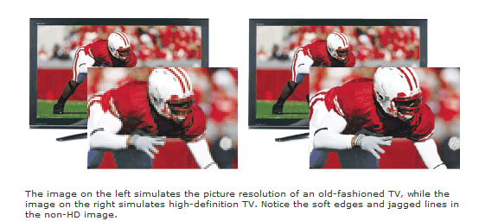
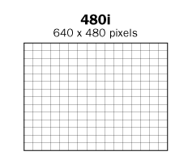
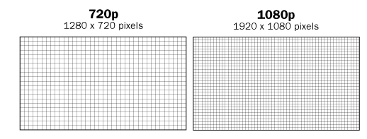
How do we see images on a
CRT Display TV vs Flat Screen
http://www.crutchfield.com/Learn/learningcenter/home/understanding-resolution.html
CRT DISPLAY
HIGH DEFINITION: FLAT SCREEN
Lower resolution
Higher resolution

Slide 28
Older TVs →480 Scan Lines (interlaced)
New Plasma, Flat Screen → 720 or 1080 lines
→ progressive
OLDER TECHNOLOGY
Screen resolution 480
Electron gun beam activates the dots
PLASMA or LCD
Screen resolutions of:
720p or 1080p
Flat grid of pixels
http://www.crutchfield.com/learn/learningcenter/home/tv_flatpanel.html?page=2
http://www.crutchfield.com/S-EMMmc3InSom/learn/learningcenter/home/tv_flatpanel.html
http://www.crutchfield.com/Learn/learningcenter/home/understanding-resolution.html?page=2

Slide 29
Displaying Video
Resolution Comparison
Format | Lines of Resolution (measurement of image quality)
VHS, VHS-C | 240 lines
8mm | 240 lines
Hi 8mm | 400 lines
Most older TVs (standard, SDTV) | 480 lines
DV 8mm, Mini DV | 480 lines
High Definition (HD) TV | 720 lines Or 1080 lines
Digital Advantage:
higher resolution
(# of _horizontal lines_)
Depending on features of individual unit, you may be able to achieve:
Notes:
IMPORTANT KNOW THIS CHART ****

Slide 30
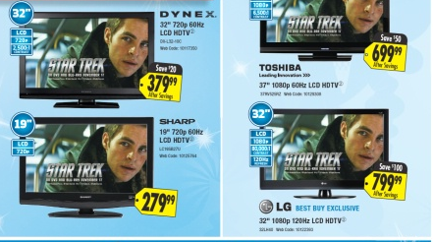
Newer TVs
http://www.crutchfield.com/Learn/learningcenter/home/understanding-resolution.html
Question: On a newer HD TV, what does the circled area mean?
720p, and 1080p displays all of the lines of resolution sequentially in a __single pass__
Result:
smoother, cleaner image, especially with sports and other motion-intensive content

Slide 31
In Lab – MovieMaker
Learning to edit your video
Capture Video
(using video capture card)
from camcorder to computer
Edit
Digital Video
(using Computer,
Digital Video software
ex. Adobe Premiere, Avid)
Edit it
Add all kinds of cool titles
Filters, transitions and FX
Superimpose clips
Synchronize audio with video
Output in different file formats
Output Video
(back out to tape, the Web, CD, DVD)
In Lab – MovieMaker
Movie on Adobe Premier

Slide 32
Let’s Review
Which is faster: Firewire 400 or USB 2.0 or Thunderbolt? (know the various speeds and type of technology Thunderbolt
Every Apple computer has a firewire port, true or false ? False
What was the Frame Rate for NTSC TVs in the 80s? Color was introduced – 29.97fps
What is the Frame Ratio for NTSC TVs NTSC (pixels are distorted (not square) because 720: 480 is actually 3:2 radio (1.5)
What is the Frame Ratio for HD TVs
What does 1080p mean?

Slide 33
Major Assignment
Major Assignment - 20%
MARKING CRITERIA
Technical: File organization, file names (lower case)
Color Creativity: do colors balance? Esthetically pleasing, creative?
Website Design: Content, layout, style, links, consistency
Video: Word overlays, transformations, music, style
Animation: creativeness and how it was incorporated in the website
EVERYTHING MUST BE WORKING TEST IT ALL

